Slide 1
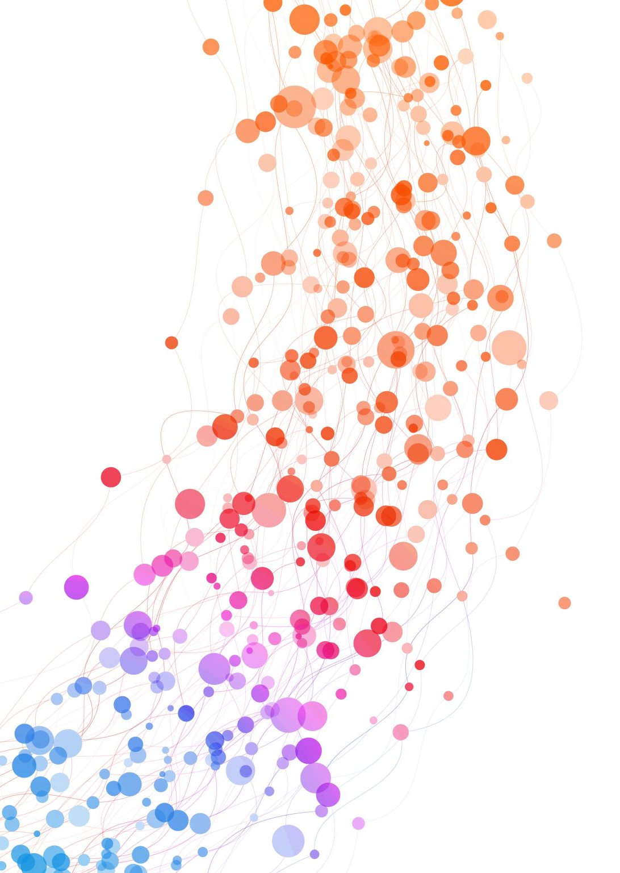
EMS Forecast
A Riipen Project

Slide 2
EMS Call Lifecycle
Call Intake
Dispatch & Response
Patient Care
Handoff & Closure
PSAP Call Received
Unit Acknowledges & Start Moving
Unit Arrives on Scene & at Patient
Dispatch Notifies the Unit
On-scene Care & Departure
Transport & Arrival at Destination
Call Wrap-up
eTimes.01 – PSAP Call Date/Time (911 call rings requesting EMS).
eTimes.04 – Dispatch Acknowledged Date/Time (if used).​
eTimes.05 – Unit En Route Date/Time (vehicle starts moving).
eTimes.03 – Unit Notified by Dispatch Date/Time (EventTime_raw).
eTimes.06 – Unit Arrived on Scene Date/Time (vehicle stops at scene).
eTimes.07 – Arrived at Patient Date/Time (crew at patient’s side).
eTimes.09 – Unit Left Scene Date/Time (depart scene with patient).
eTimes.11 – Patient Arrived at Destination Date/Time.
eTimes.12 – Destination Patient Transfer of Care Date/Time.
eTimes.13 – Unit Back in Service Date/Time.​
eTimes.16 – EMS Call Completed Date/Time (if captured).

